Slide 1



Power Bi SN Corp Analysis
View in Power BI
Presented by Vaibhav Pawar
Last data refresh:
7/9/2024 2:57:06 PM UTC
Downloaded at:
7/9/2024 3:57:49 PM UTC

Slide 2
SN Corp Analysis
1.1 Cleaned and preprocessed data to ensure accuracy and consistency.
1.2 Performed statistical analysis and generated graphical representations using Power BI.
1.3 Utilized Power Query Editor to clean and transform data, enhancing visualization quality.
1.4 Developed and visualized interactive Power BI dashboards, focusing on key business metrics and insights.
Metrics Analyzed:
Total Sales
Total Cost
Total Profit
Top Customers
Top Products by Profit
Technology Used: Power BI.
Dataset: https://docs.google.com/spreadsheets/d/1VYpefd_E9NoNTocfB4cVms_zcXj2mE3Y/edit?usp=drive_link

Slide 3
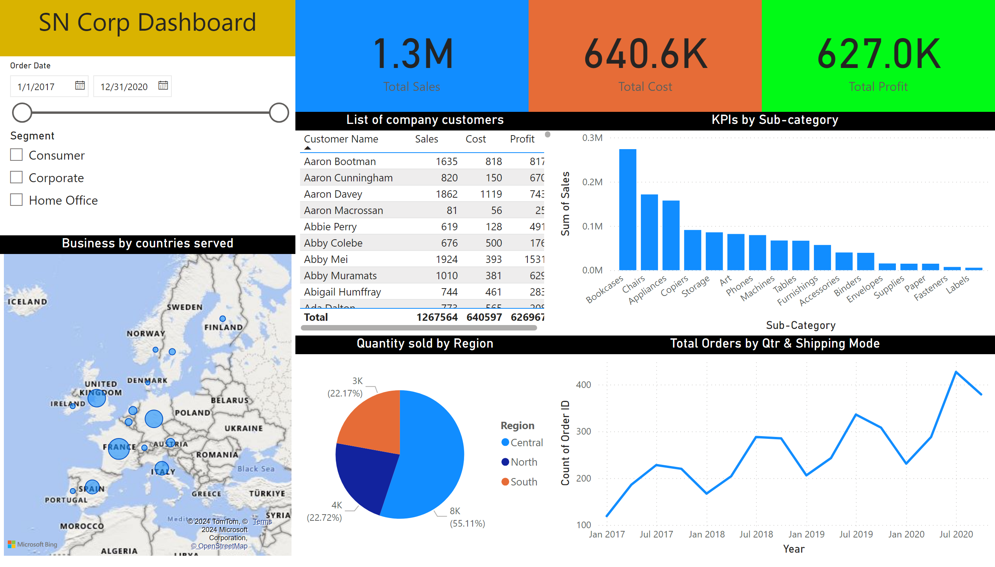
Page 1

Slide 4
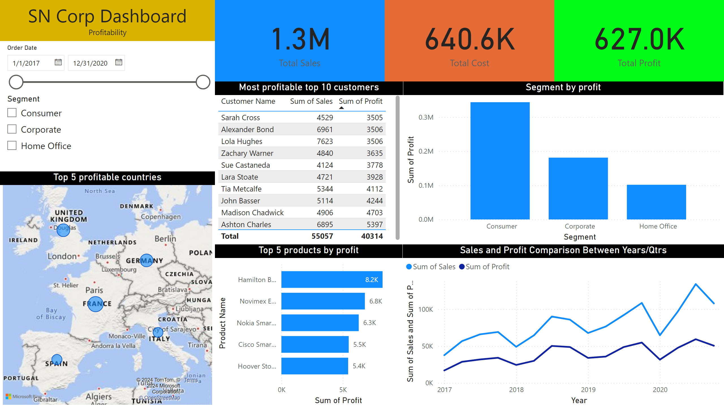
Page 2

Slide 5
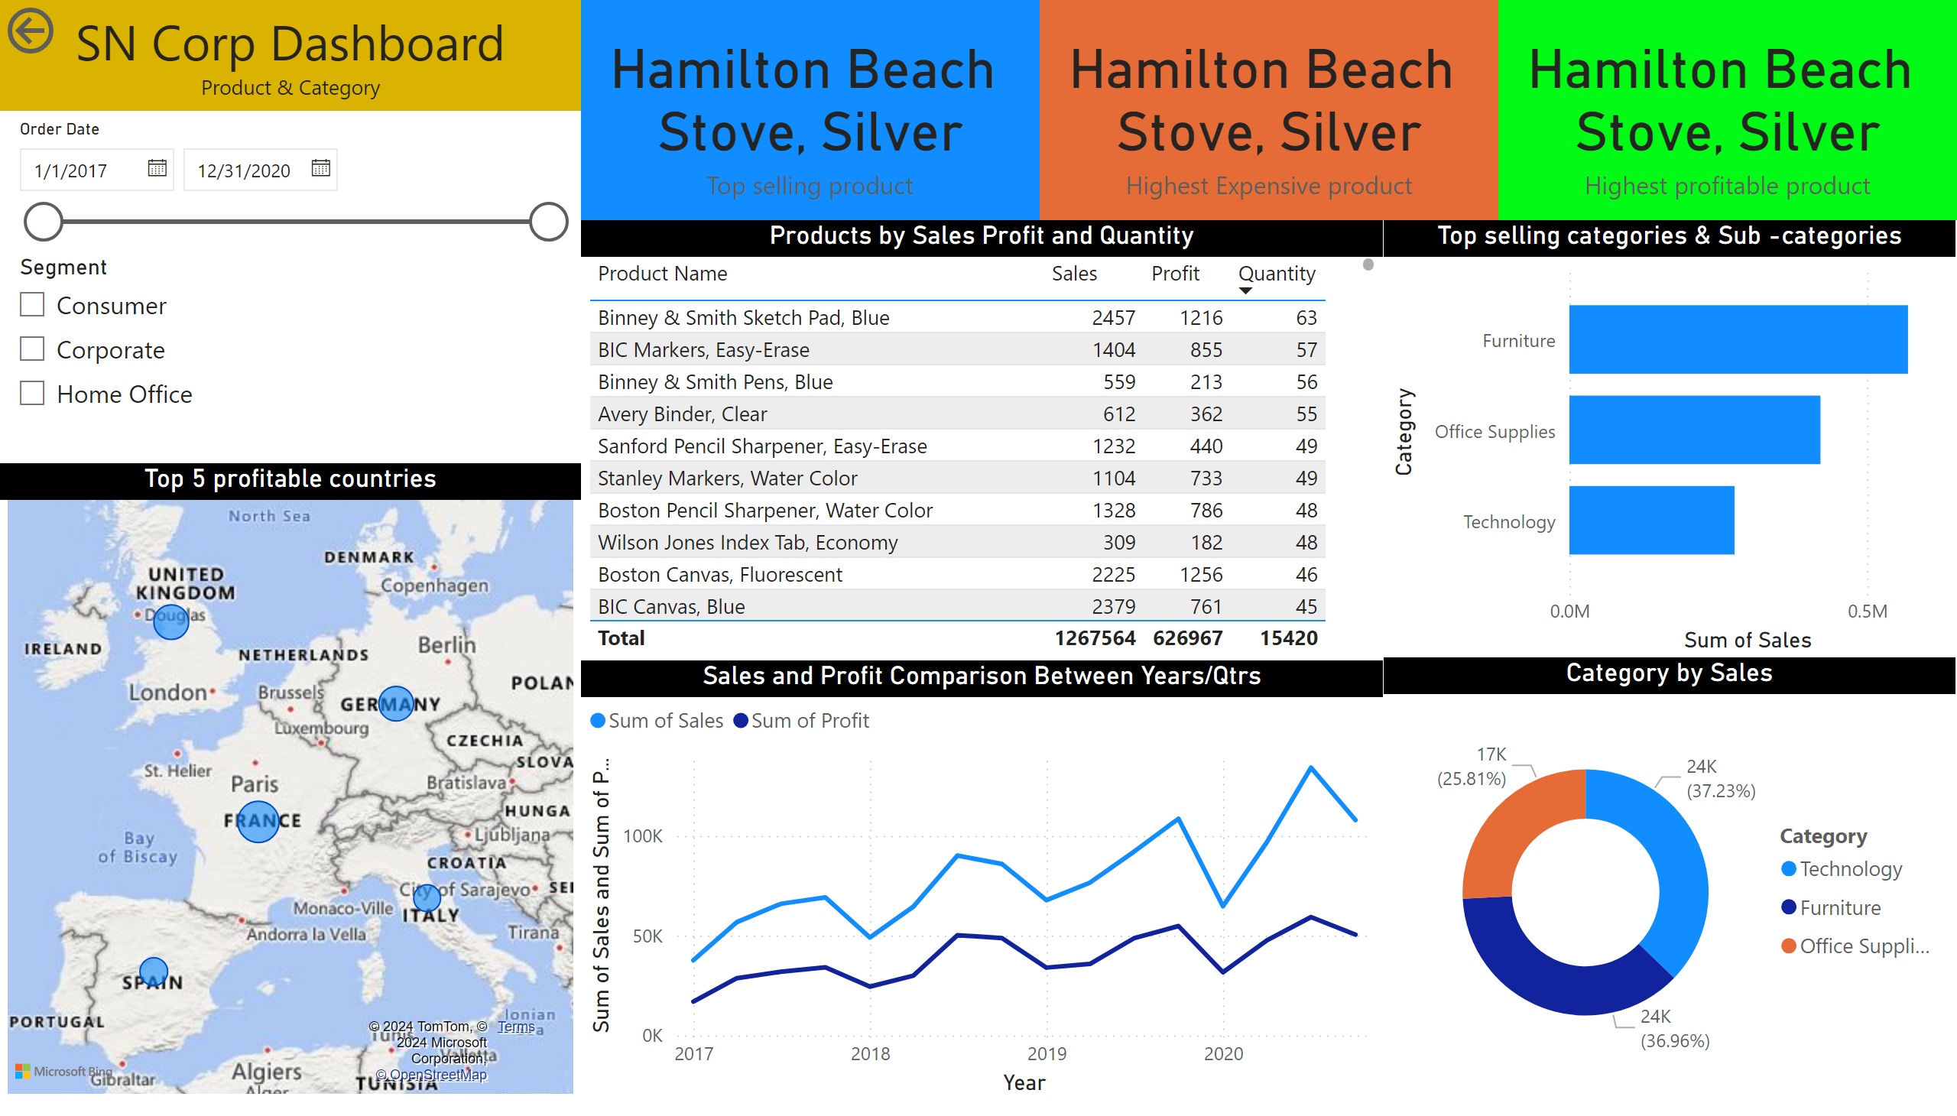
Page 3

